Slide 1
Munna Bhai M. B. A @ ITM – Kharghar Dec 2012

Slide 2
Shanti Eva Jayate
http://sej2010.p4pune.com/
In Association with

Slide 3
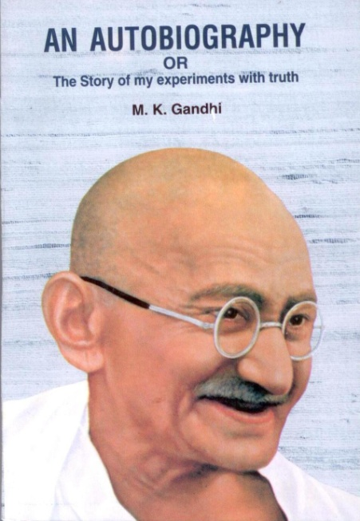
Munna Bhai M. B. A
What the Program is all about ?
ITM students campaign Gandhi autobiography copies in Mumbai Market

Slide 4
About the Book-
My Experiments with Truth – By M K Gandhi
462 pages, MRP Rs. 40 / -
Published by Navjeevan Publishers, Ahmadabad
Supplied by M / S. Bombay Sarvodaya Mandal
Considered to be the Best Autobiography

Slide 5
Munna Bhai M. B. A
Objectives of the program
Learning MBA lessons ( Marketing, Communication, Consumer behaviour, Leadership, Market research etc. ) through Munna Bhai M. B. A the field experience
Demonstrating ITM Brand to Mumbai Mandi
Helping Gandhian literature to reach Mumbai citizens

Slide 6
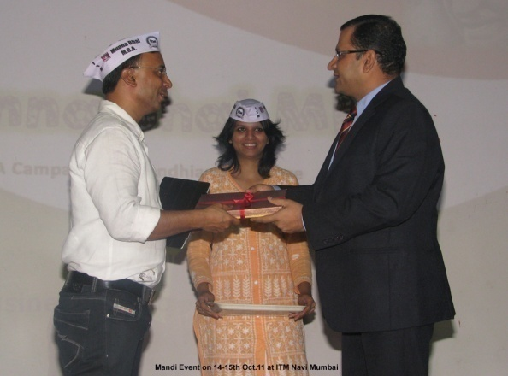
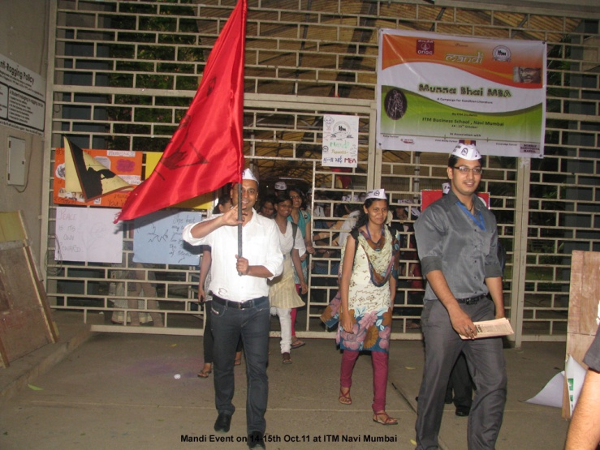
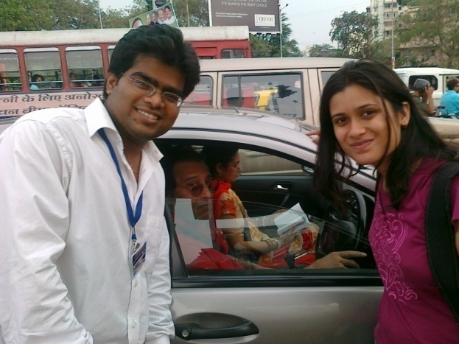
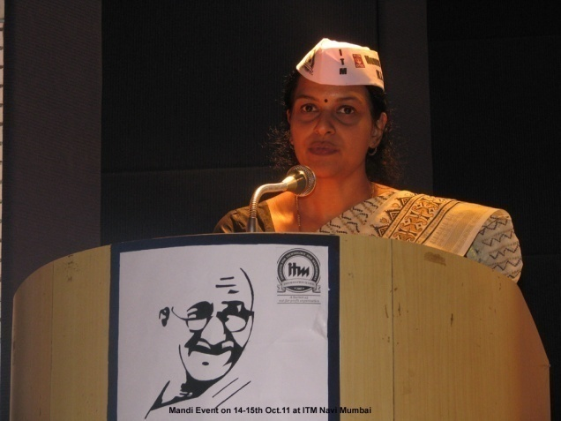
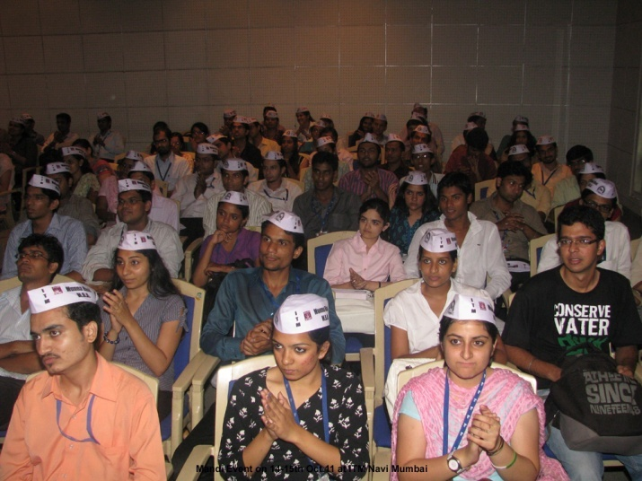
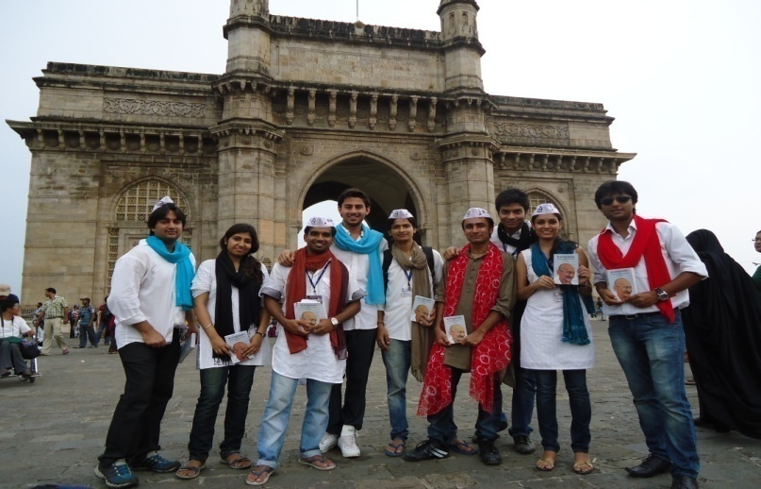
Munna Bhai M. B. A

Slide 7
Milestones
30,000 copies are sold
3,000 students participated
Gandhi reached 200 companies

Slide 8
Testimonials
“A unique event. Keep up the good work” – An employee at Godrej
“Best platform for student interaction with corporate” – An employee at Crisil
“We need students to popularize the values which Gandhi stood by” – An employee at IOCL
“Need more such activities. Thanks for involving us in this event” – An employee at Asian Paints
“Gandhi needs to be popularized among the youth of this country. What better way than the youth themselves to uphold the values” – An employee at Mastek

Slide 9
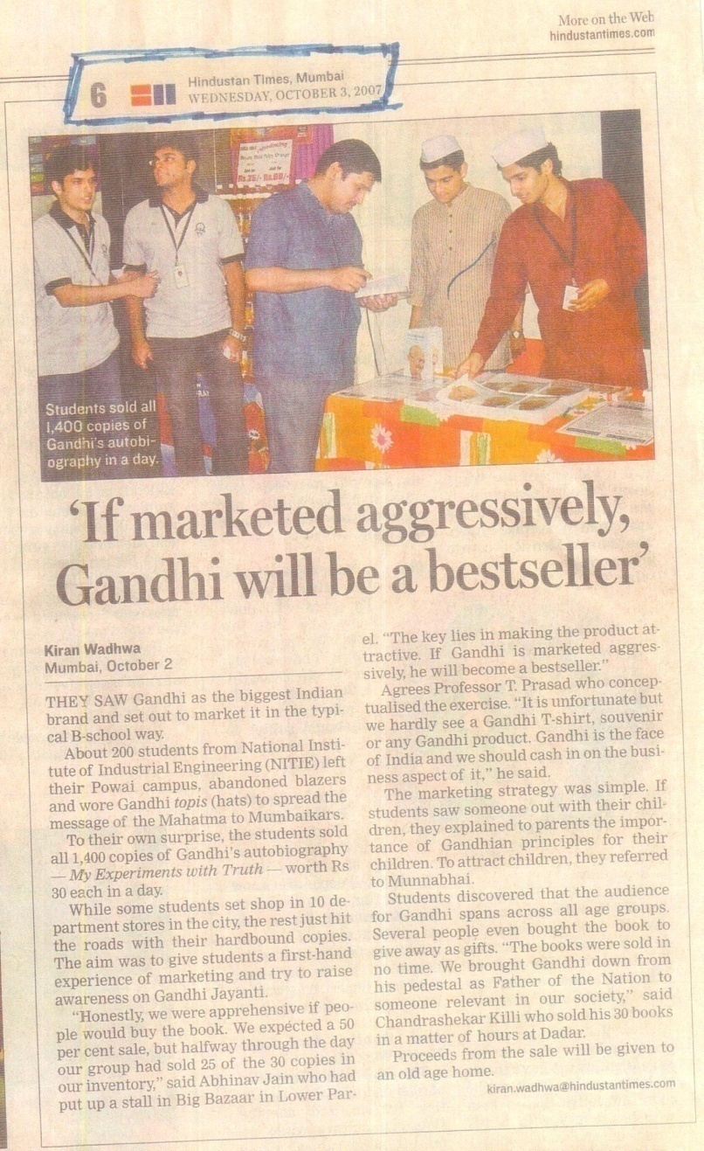
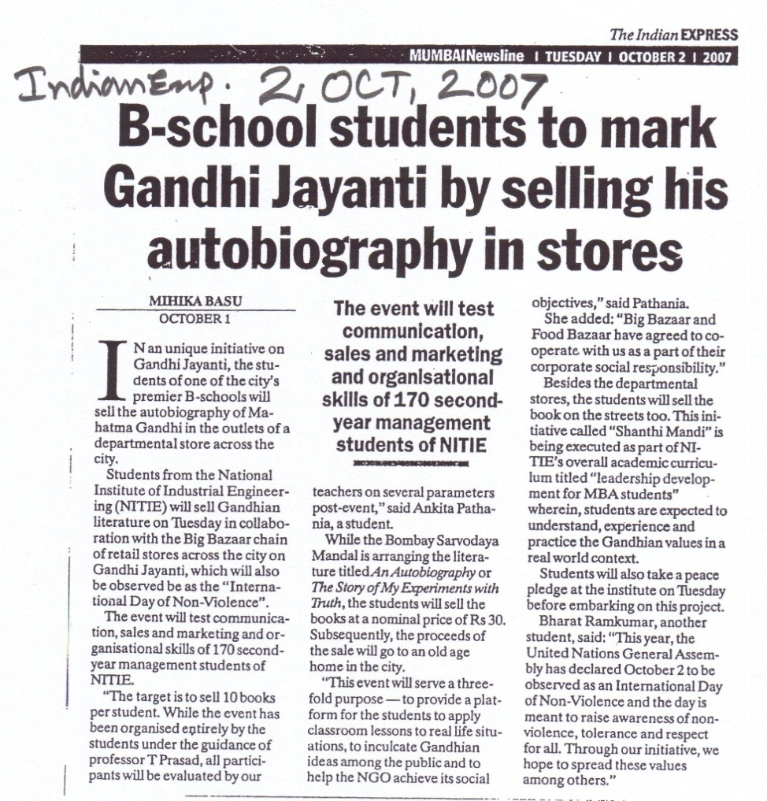
Media Coverage

Slide 10
Munna Bhai M. B. A
Important things :
Planning Inauguration event
Industry guests & Glamour guests
Media coverage – Print media , On line, Radio, YouTube promos, Blogs and Face book promos
Training inputs for the participants
Curricular learning:
Face book pages, Blogs writing, Self learning Reports, You Tube videos
Closing of the ceremony
Panel discussion on Gandhian Thoughts and Management

Slide 11
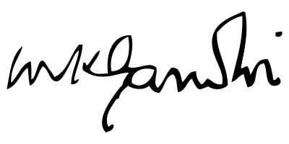
Thank you

